Slide 1


Crime Data Analysis of Chicago , IL (2022)
Presented By:
Prince Kumar Singh
(Using PowerBI)

Slide 2
Objective
To analyze efficiency of implemented policies in Chicago , IL,
and if they were successful or not.

Slide 3
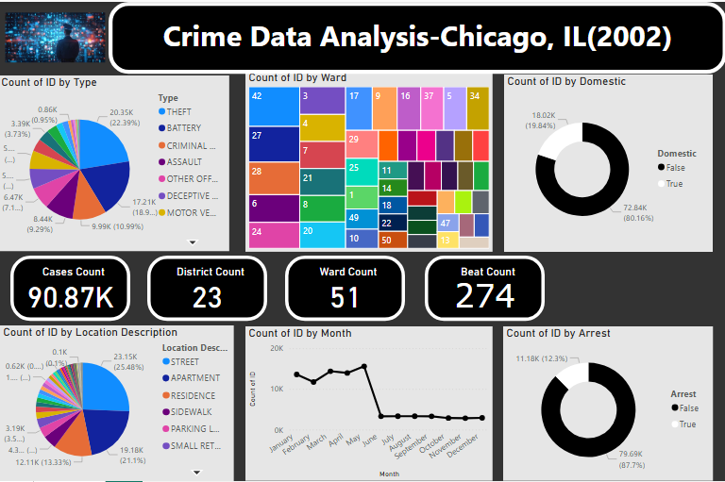
KPI’s with their data

Slide 4
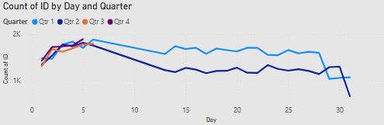
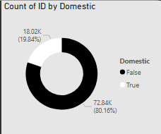
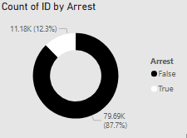
Crime Analysis Overview
Domestic, Arrest, and Quarterly Trends

Slide 5
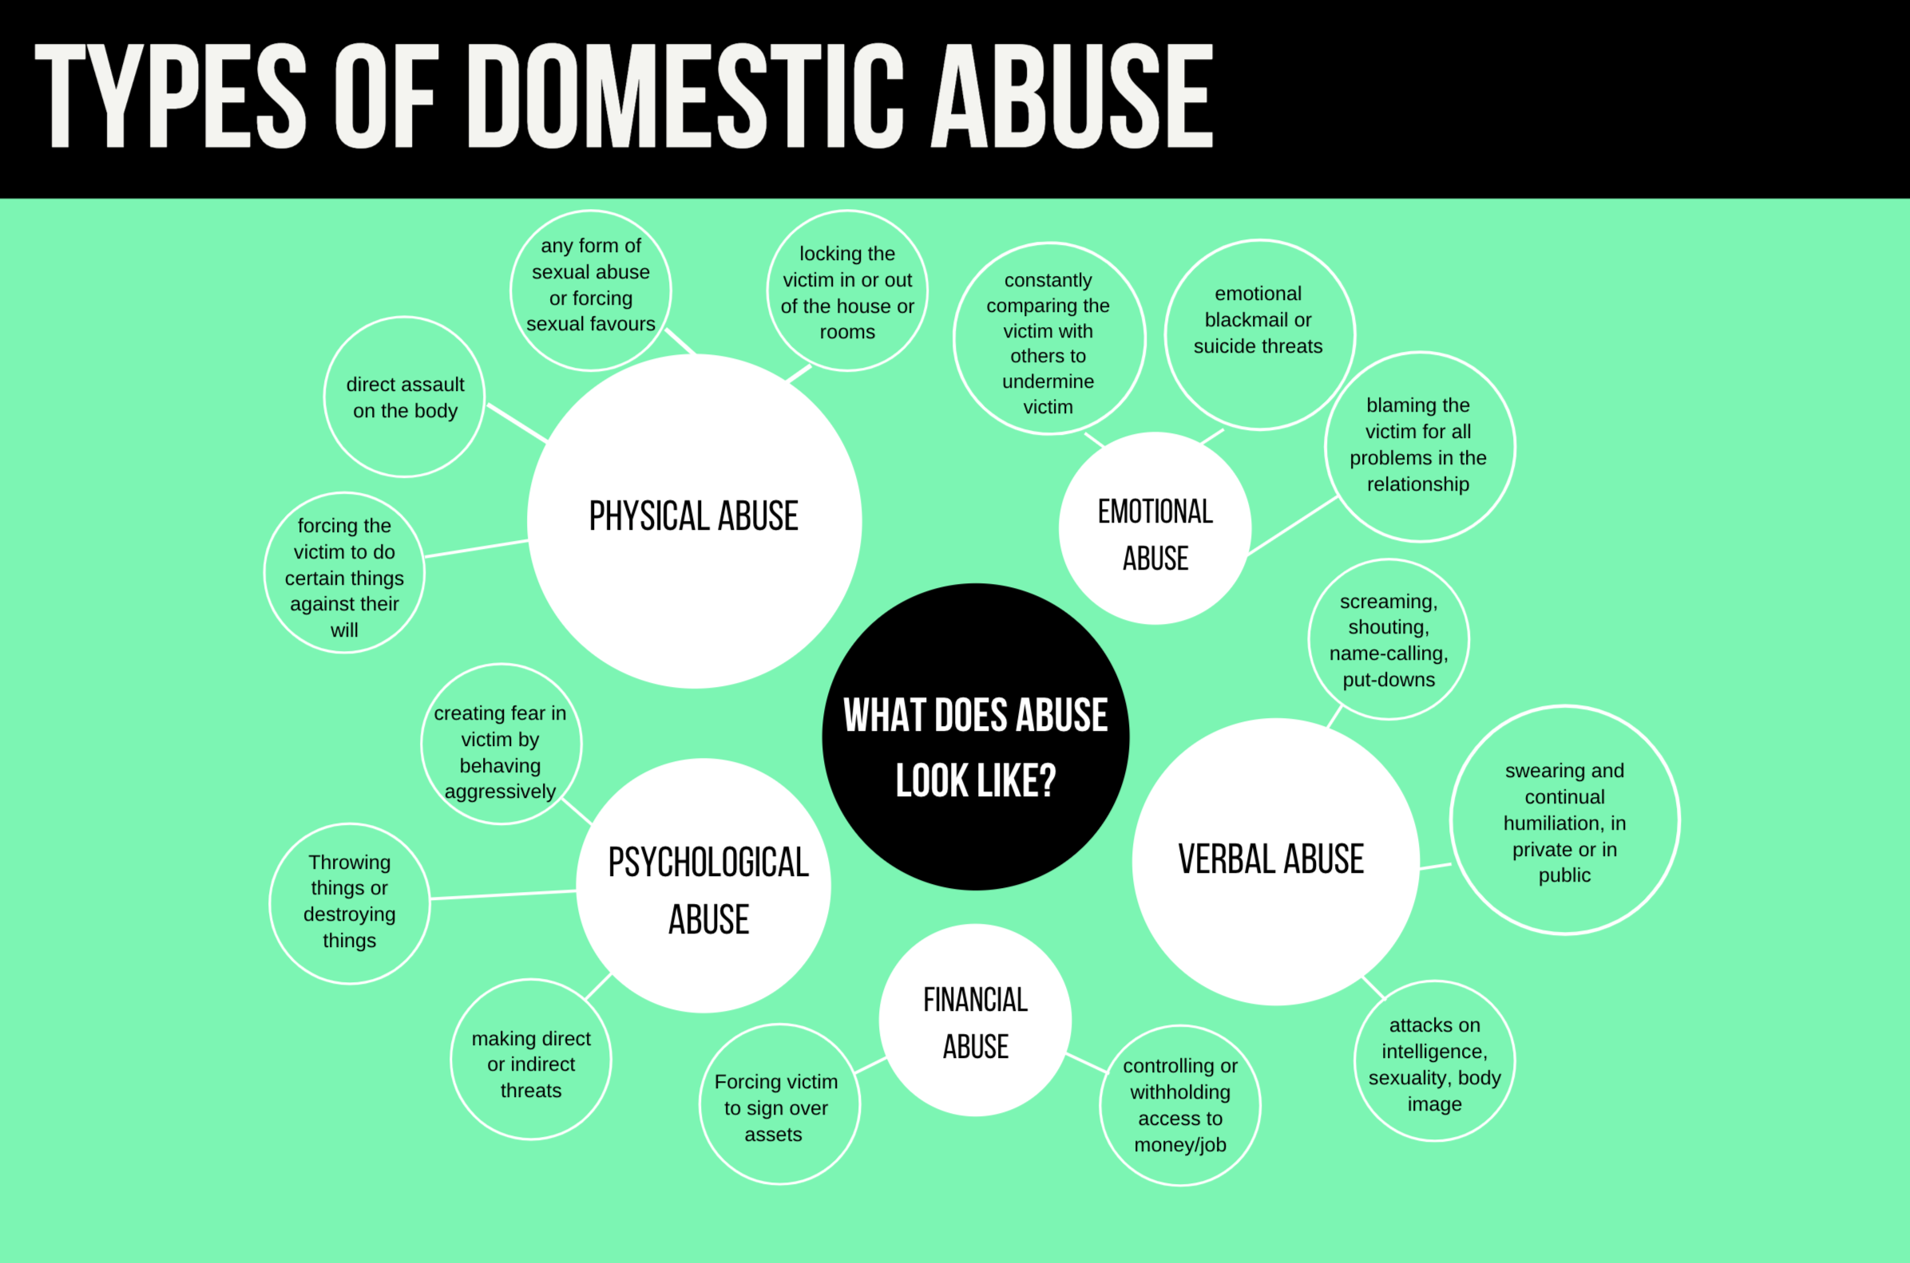
Domestic Specific

Slide 6
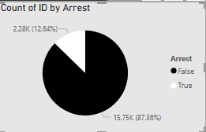
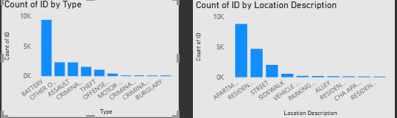
Domestic Data

Slide 7
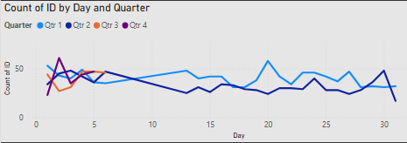

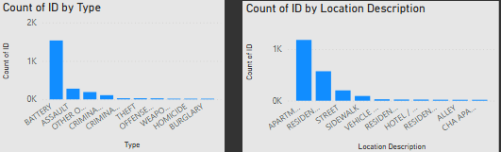
Domestic (Arrest)

Slide 8
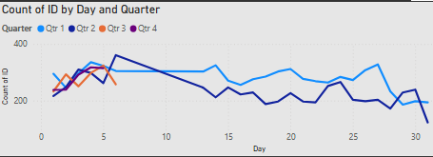

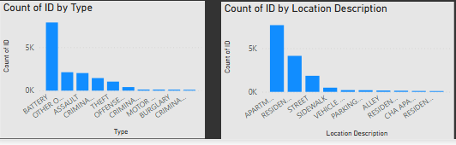
Domestic (No Arrest)

Slide 9
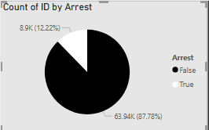
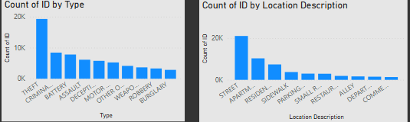
Non-Domestic Data

Slide 10
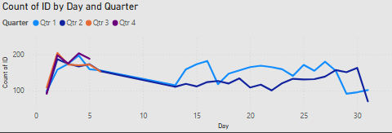

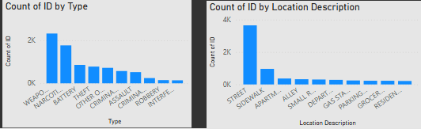
Non Domestic(Arrest)

Slide 11
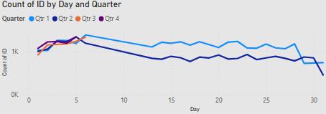

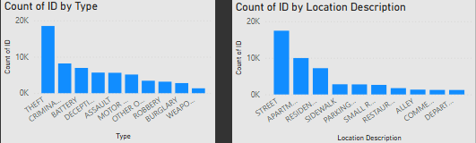
Non Domestic (No Arrest)

Slide 12
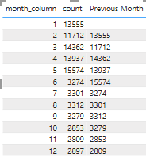
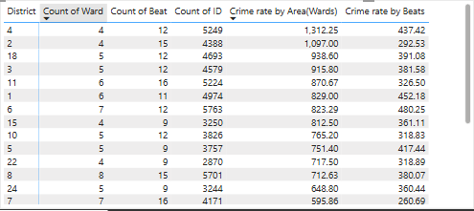
Tabular Summary

Slide 13
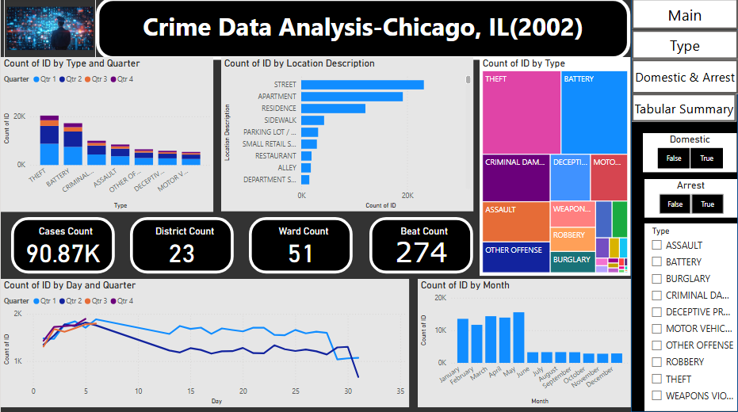
PowerBi Dashboard

Slide 14
Conclusion
The most common Domestic crime, which led to an arrest was of type “Battery”, and most common area was Apartments.
The most common Domestic crime, which doesn’t led to an arrest was again of type “Battery”, and most common area was Apartments.
The most common Non-Domestic crime, which led to an arrest was again of type “Theft”, and most common area was Streets.
The most common Non-Domestic crime, which doesn’t led to an arrest was of type “Weapons And Ammunition”, and most common area was Streets.

Slide 15
Thank you

